Slide 1
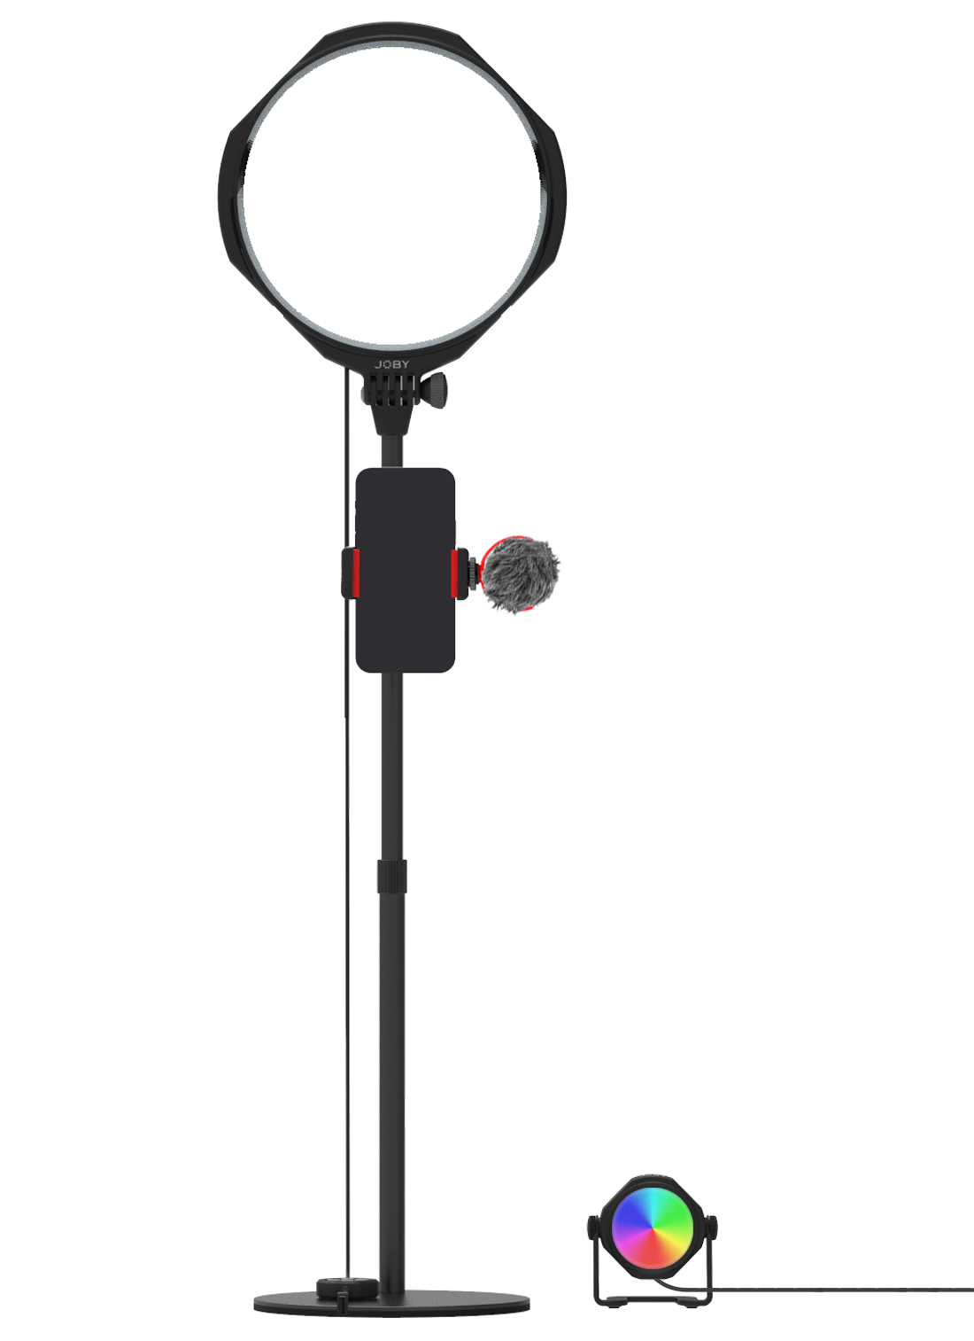
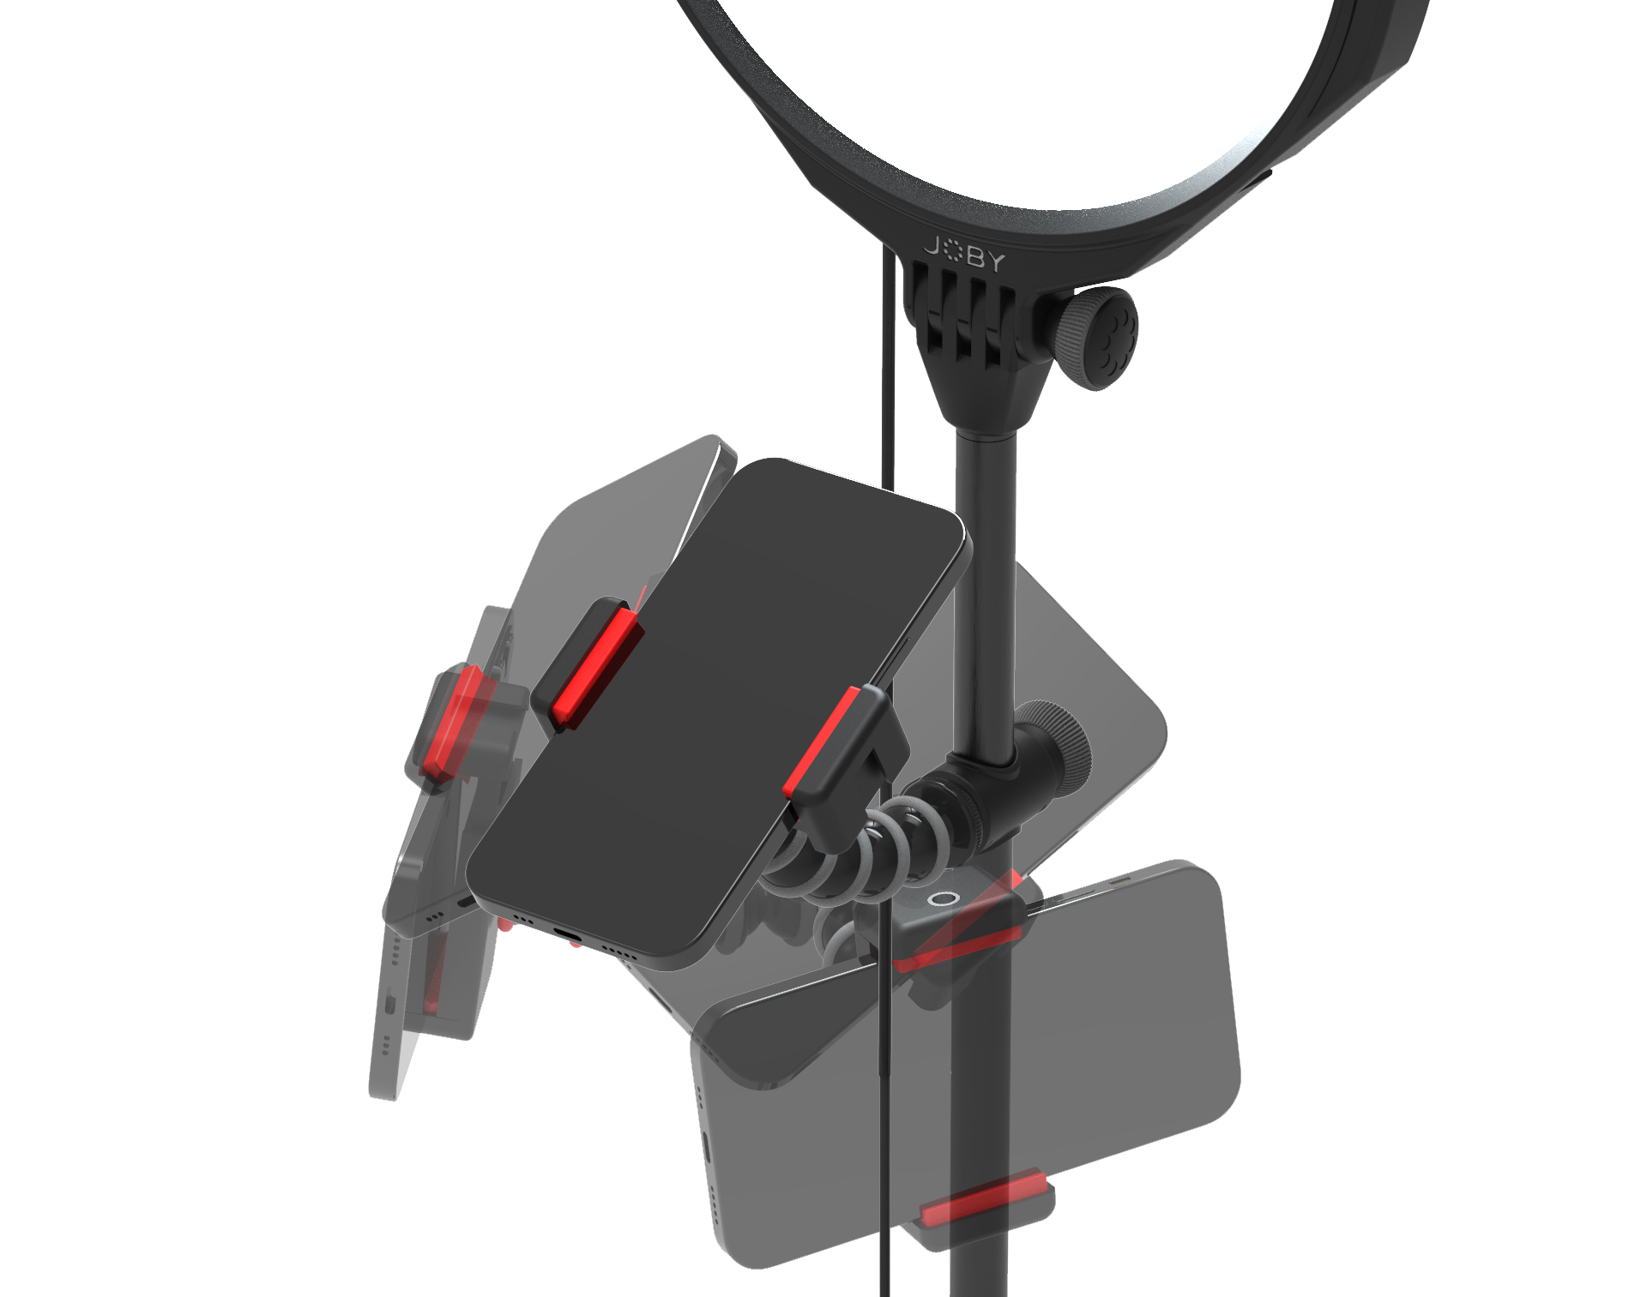
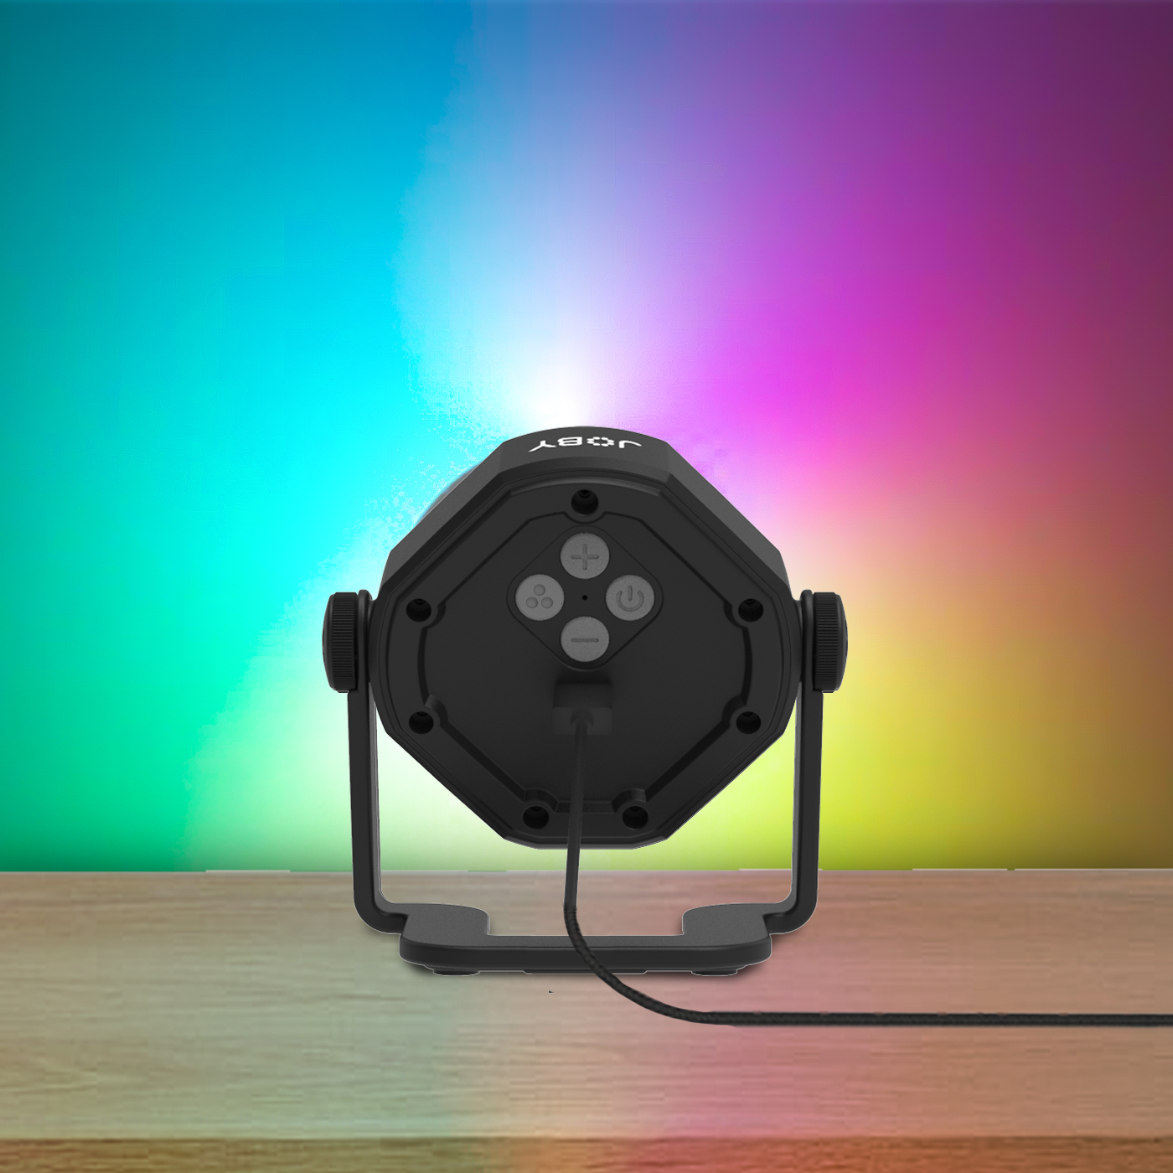
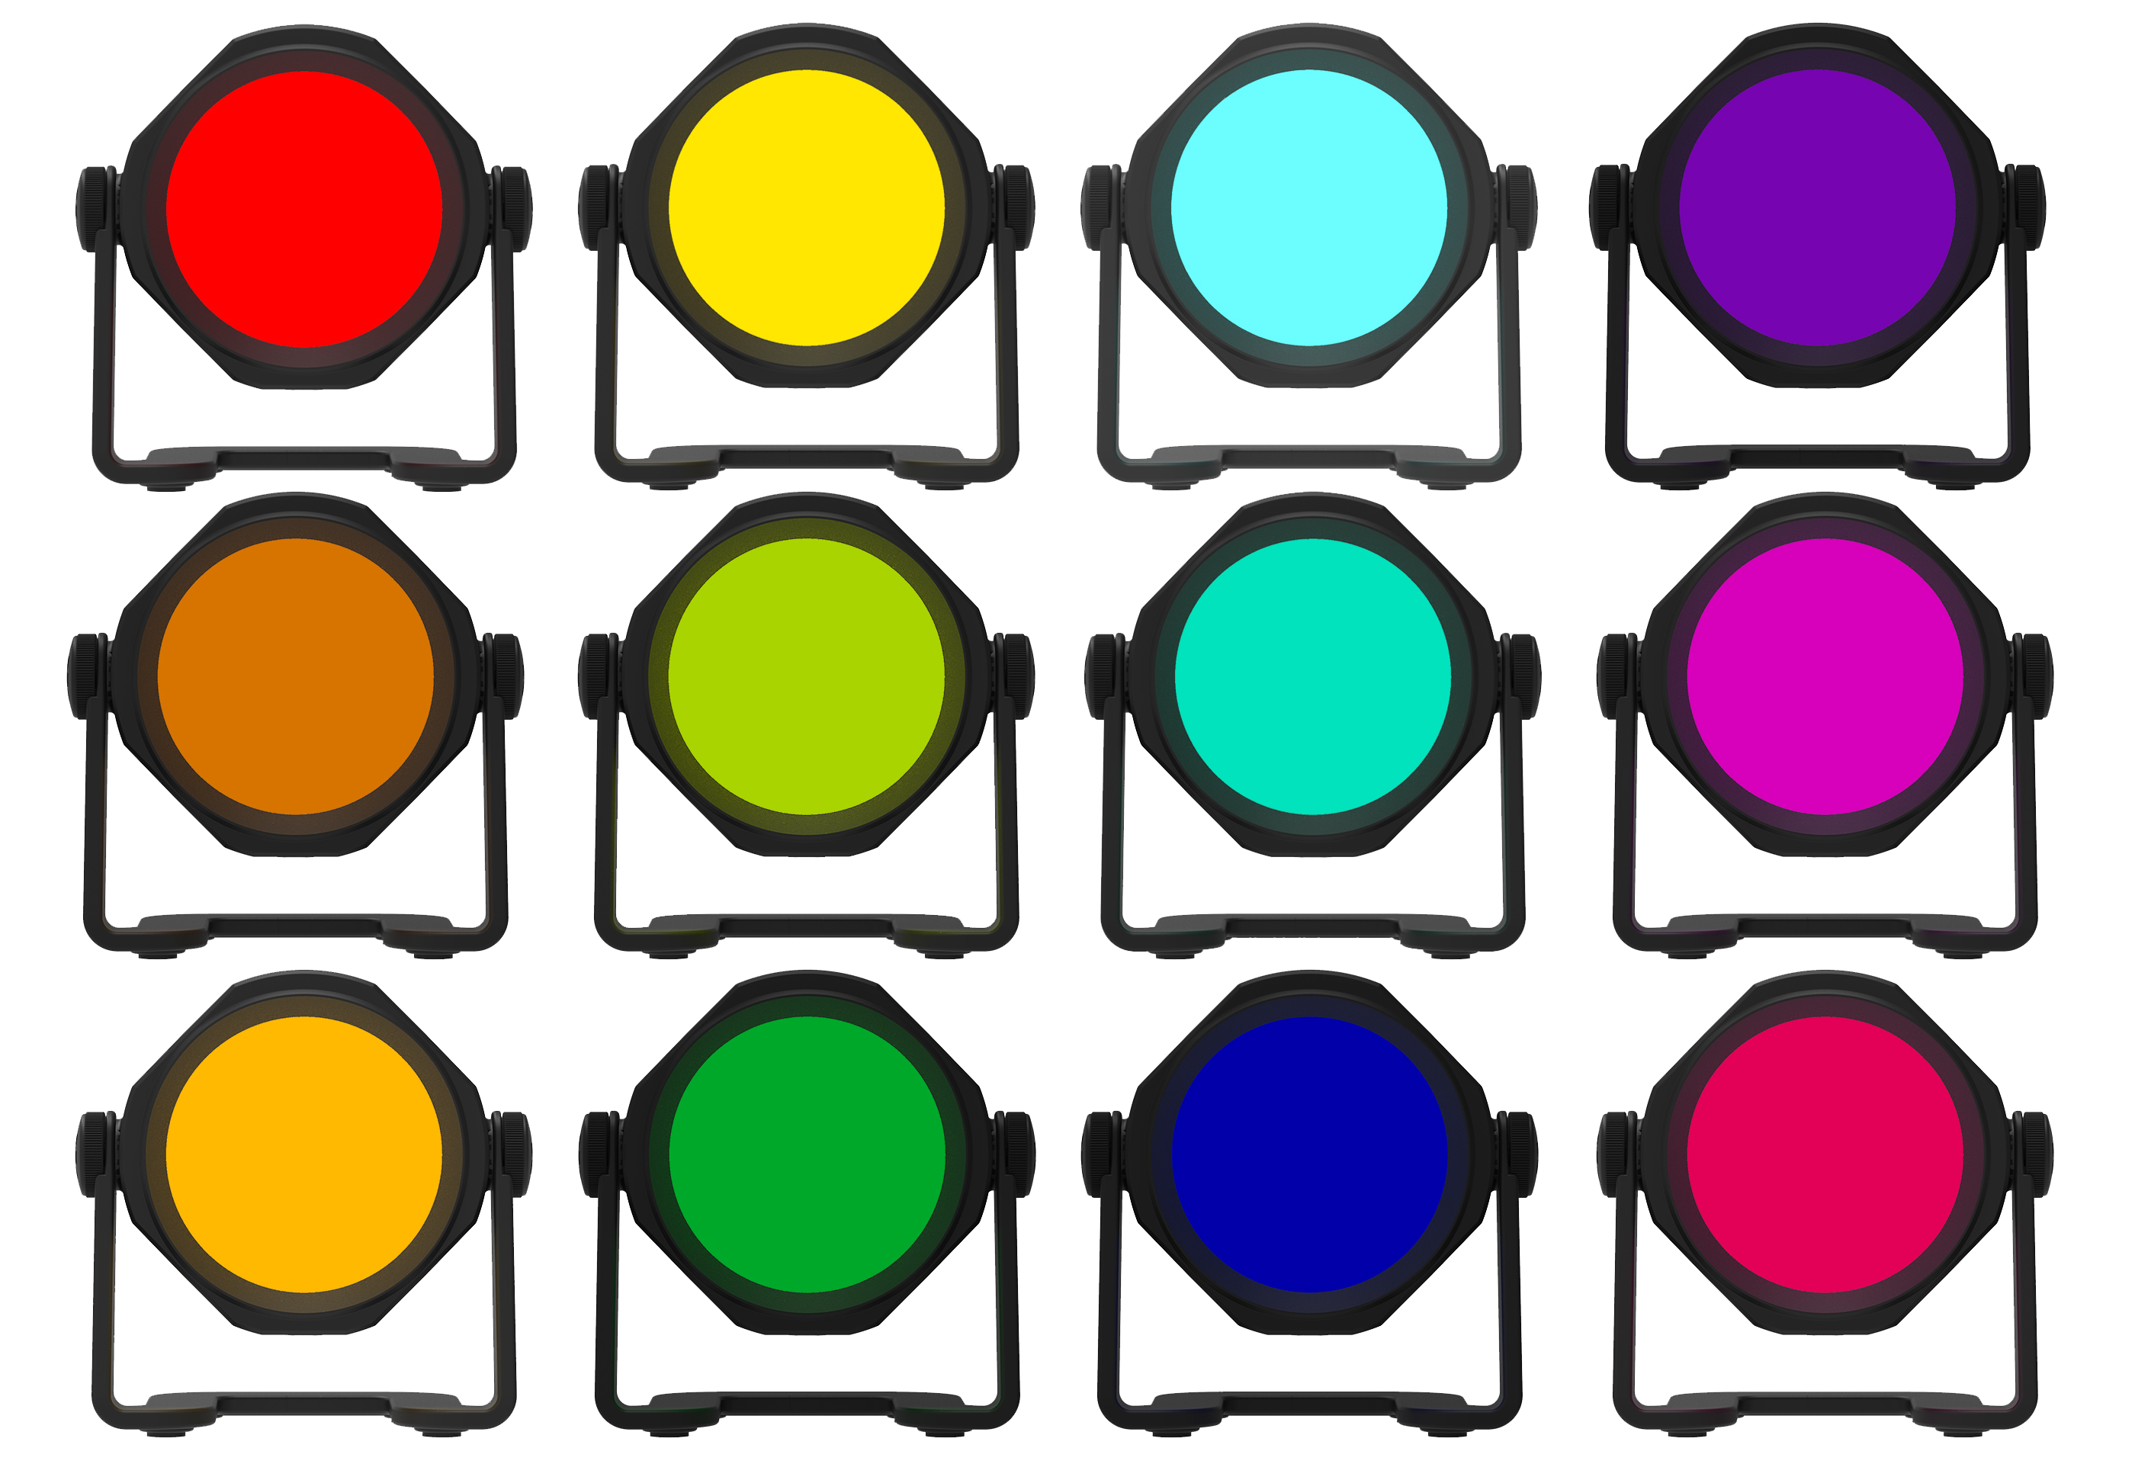
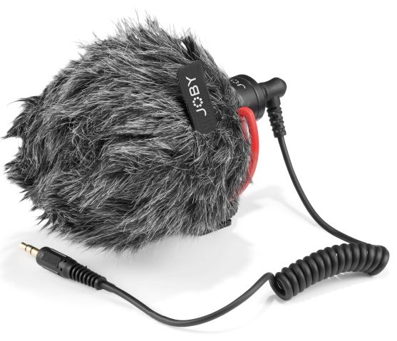
JOBY Beamo™ Studio Creator Kit
All-in-one YouTube home studio kit with LED key light, background light and microphone
JB01835-BWW
Sell Sheet
A complete video lighting and audio solution for your first YouTube home studio.
The Beamo™ Studio Creator Kit covers all you need to start a channel from your home, including a key light, a color background light and a microphone.
Create engaging contents with the easy-on-eyes Beamo™ Studio Key Light. Built-in Soft-Lens light diffusion ensures you will get the best image quality for your talking head videos. 10 brightness levels and 3 color temperature can be controlled by the supplied cable remote which also magnetically attaches to the base of the table stand.
The table stand allows the key light to tilt and be raised to ideal height (68-95cm/27-37") for the shoot. The phone mount is supported by a flexible GorillaPod® Arm for easy angling and framing. Add the supplied Wavo™ Mobile mic to the cold shoes on the key light or on the phone mount to improve the audio quality of your phone or your camera.
Finally, make your videos stand out by adding color to your background with the multi-angle, 10 brightness levels and 12 colors adjustable Beamo™ Studio Background Light. Both lights are USB-powered.
Materials: ABS, Stainless steel, TPE, Aluminum, Hytrel®, PU
Lux @ 0.5m: Key: 650 ±10% Background:90 (Red color) ±10%
What’s in the box: Key light, table stand, phone mount, flexible arm, background light & USB power cable, Wavo Mobile microphone, TRS cable & TRRS cable
Flexible
GorillaPod® Arm
for easy phone angling and framing
Soft, easy-on-eyes
key light
to create engaging contents
Wavo Mobile™ microphone
supplied to deliver high-quality audio
12 background light color options to make your videos stand out

