Slide 1
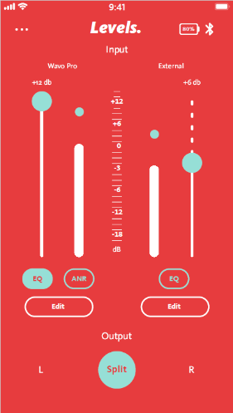
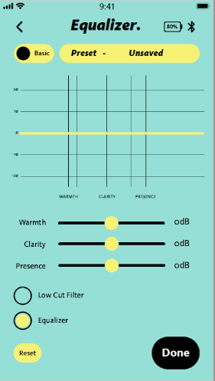
GorillaPod PRO Vlogging Kit
Professional Vlogging kit, The new Iconic JOBY silhouette
JB01799-BWK
Sell Sheet
Make a statement while producing top quality content.
Built for storytellers, filmmakers and expert creators, the GorillaPod PRO Vlogger Kit is the ultimate complete PRO kit, designed to pair with the latest mirrorless camera hardware and brings professional-grade audio performance with a best-in-class flexible support solution
Wavo ™ PRO features revolutionary Active Noise Reduction and a dedicated smartphone APP with advanced sound shaping and managing capabilities (available on IOS and Android). Designed to create filmmaking-like content with balanced, crisp, refined sound.
The GorillaPod 3K PRO is a sturdy and compact, all-aluminum construction flexible tripod with a strong and convenient ball-head with smooth pan operation.
Materials Aluminium, ABS, , Hytrel®
Colour
Black/Grey/Red
Polar Pattern: Super Cardioid Frequency Response: 20Hz – 20KHz (+/-3dB) Signal to Noise Ratio: 98db +-2db
Sensitivity:19mV/Pa or -34,4dB /Pa (+/-3dB) Plug: USB-C Max Level: 295 mV RMS (416mV peak)
Bluetooth: 5.0
Dimensions: Wavo PRO 135x115x52 mm
3K PRO Kit 300 x 53 x 77 mm
Total Weight: 623g
Manufacture Warranty : One Year Warranty
Wavo ™ PRO
Secondary Mic Input for lav or wireless unit
Active Noise Reduction removes bumps and handling noise in real time
JOBY Design: compact size and premium sound, a perfect fit for mirrorless cameras
Safe Track function to protect your recording from distortion and clipping
Front & Back LEDs communicate real time the sound and battery levels to be always in control
GorillaPod ™ 3k PRO Kit
Designed for Premium Mirrorless Cameras with a more compact shape
Patented Aluminum Socket Construction
Supports up to 3Kg

