Slide 1
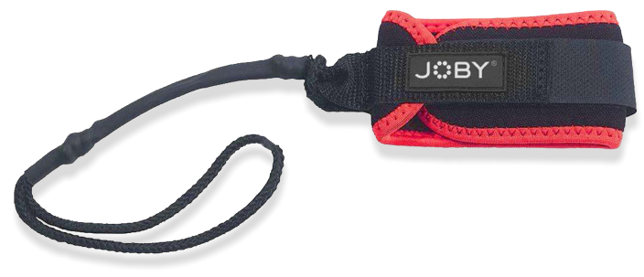
JOBY SeaPal Sports Leash
Comfortable Wrist Strap for SeaPal Waterproof Case
JB01953-BWW
Sell Sheet
This SeaPal Sports Leash was designed specifically for use with the SeaPal Waterproof Case. The leash will keep the housing tethered to your wrist, even in heavy surf. Comfortable neoprene cuff with thick braided cord. Built tough to ensure comfort and maximum strength. This simple design is the perfect length for use on the SeaPal Waterproof Case on any occasion.
JOBY has partnered with AquaTech, who has been making water housings for the world’s best ocean photographers for over 20 years. We took all of that knowledge and experience and created SeaPal. Whether you're surfing, snorkeling, fishing, freediving, kayaking or just taking photos of the kids in the backyard pool, the SeaPal protects your phone and lets you focus on getting the perfect shot.
Materials Polyurethane, Nylon, Velcro
Dimensions: 38x3x6cm(14.8x1.3x2.2in)
Net Weight: 30g (0.7 lbs)
Manufacture Warranty One Year Warranty
Tethered
to your wrist, even in heavy surf
Secure
your SeaPal Waterproof Case
Comfortable
neoprene cuff
Thick
braided cord in perfect length

