Slide 1
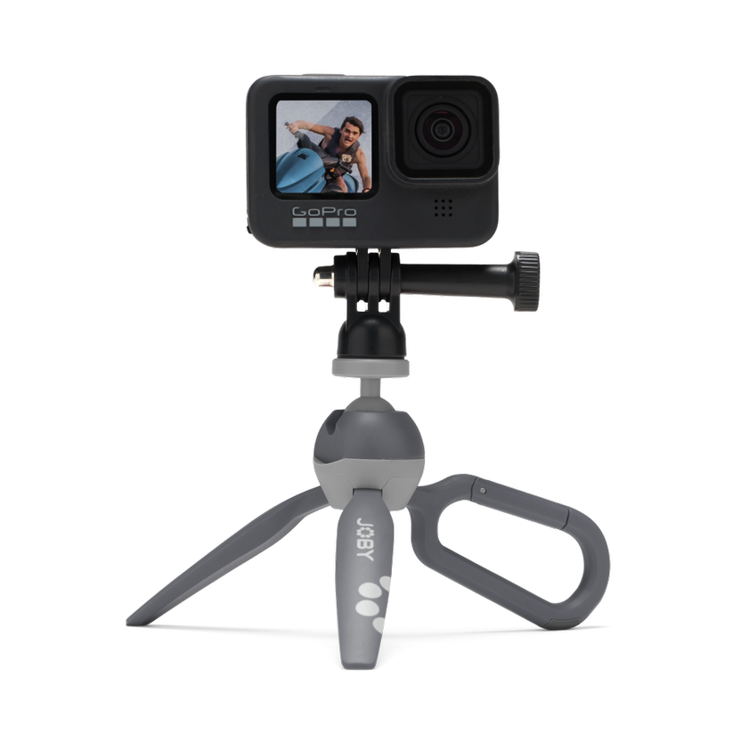
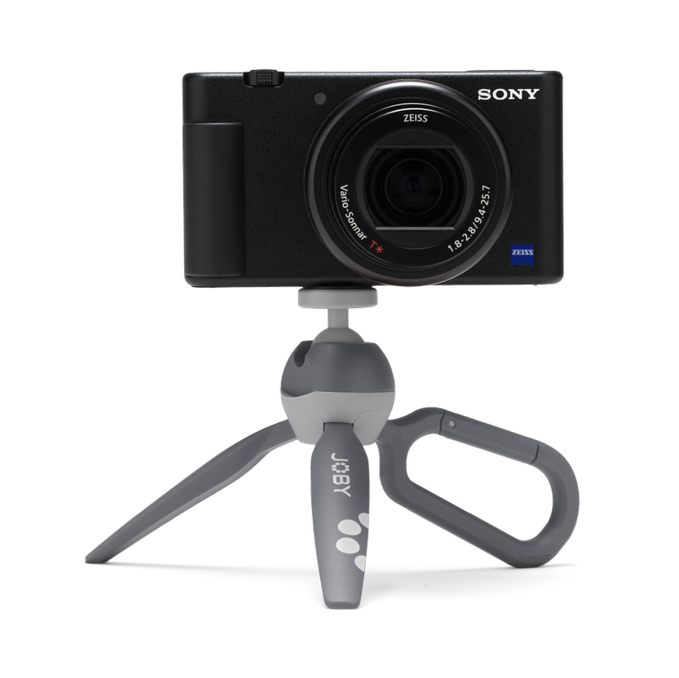
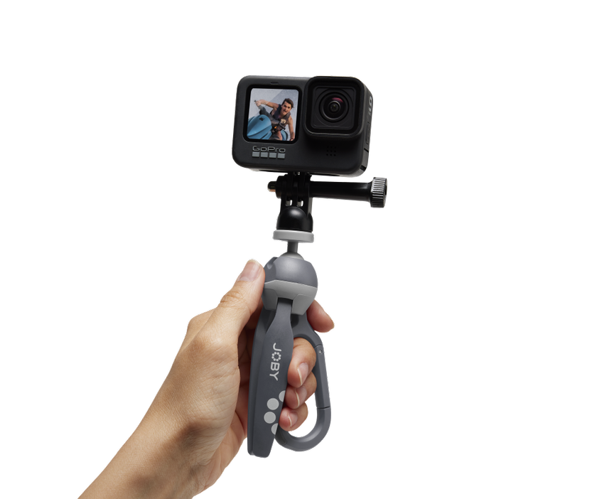
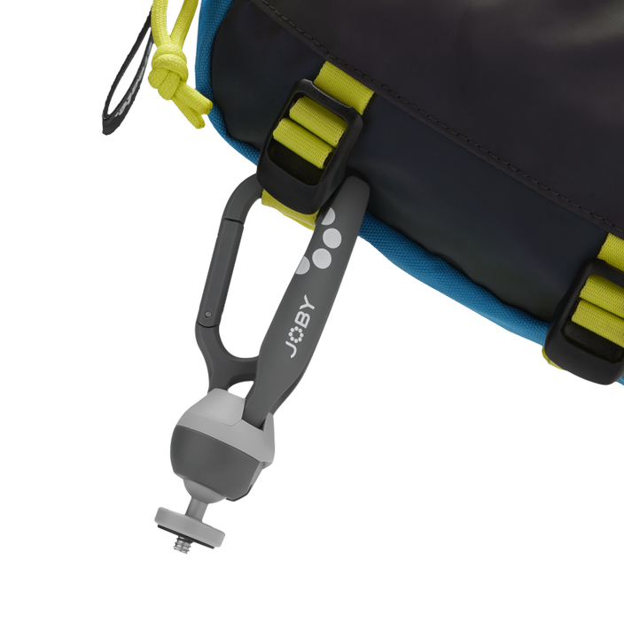
HandyPod Clip Action
The Mini GoPro Tripod with Carabiner
JB01838-BWW
MULTI-DEVICE
Compact size, supports both GoPro and compact cameras
Sell Sheet
Introducing HandyPod Clip, the super cool mini Vlogging tripod with a built-in carabiner for ultimate convenience!
Based on the wildly popular HandyPod 2, HandyPod Clip is a pocket-sized, rigid-legged tripod with a built-in ball head that transforms into a handy grip. One leg goes rogue and becomes a trusty carabiner, allowing you to hang it anywhere—backpack strap, belt loop, or even your unicorn's horn!
No more shaky vlogs or wobbly selfies. With HandyPod Clip, use the carabiner as your vlogging sidekick for a sturdy grip on your device. The built-in self-locking ball head lets you seamlessly switch from horizontal to vertical shooting, adding another level of awesomeness to your content.
Compatible with GoPro, compact cameras, video lights, and microphones, HandyPod Clip is your go-to companion for epic vlogs and unforgettable memories. Clip it on, feel the power, and let the creative journey begin—rock the vlogging world!
Payload: 1.1 lb / 500g
Dims: 6 x 1.8 x 1.3 in / 15 x 5 x 3 cm Connection: ¼-20” with included pin-joint mount
Materials: Glass-filled Nylon, Aluminum, Steel, TPE, Brass
Color Options: Grey
Manufacture Warranty: One Year Warranty
FLEXIBLE
Easy angle adjustments with self-locking ball head
VERSATILE
Sturdy tripod legs fold into a vlogging hand grip
CLIP IT!
Convenient carrying using the built-in carabiner

